Slide 1
Vaccine hesitancy
By Michael Campoverde

Slide 2
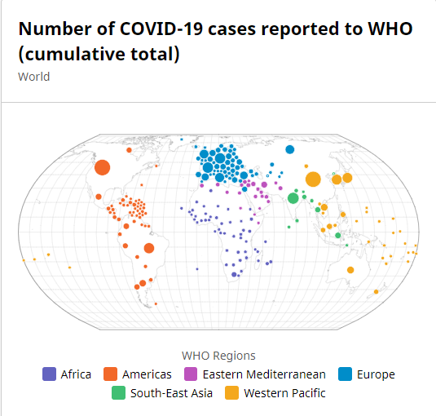
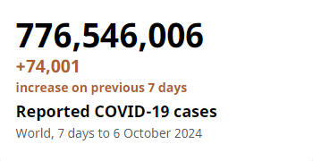
Covid-19
On March 11, 2019, Covid was a new virus and was realized as a worldwide pandemic causing many scientists to rush to make a vaccination to help secure it more.

Slide 3
Covid Vaccinations
Covid Vaccinations were fully sent out on December 14, 2020. As they were being distributed out many claimed that the distribution of vaccines were unfair and this was a widely accepted belief. Many believed there were factors that may have impacted if they were to receive the vaccine or not which led to the vaccine getting a negative reputation.

Slide 4
Research Question
Did Age, Race, Or Gender play a role in the vaccine distribution or are there other factors involved that went into the thinking and planning of the vaccine distribution? (We will be using data in the data set from 2024 - 09 -21.)

Slide 5
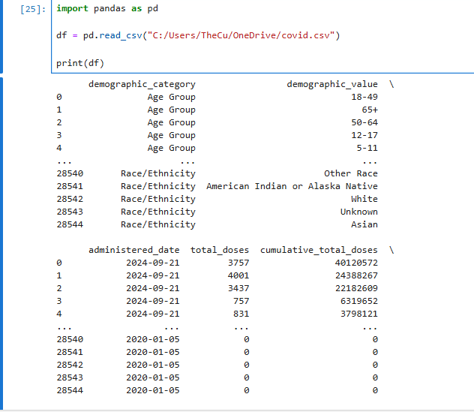
Digitizing the dataset

Slide 6
Columns presented
‘demographic_category'
'demographic_value'
'administered_date'
'total_doses'/'cumulative_total_doses'/'partially_vaccinated'
'total_partially_vaccinated'/'fully_vaccinated'
'cumulative_fully_vaccinated'/'at_least_one_dose'
'cumulative_at_least_one_dose'/'up_to_date_count'
'cumulative_up_to_date_count'

Slide 7
“Important” Columns
Demographic_category - Age Group, Race, Gender
Demographic_value - 11 - 17, White, Male
Total_Doses - Male (5432 total doses in 2024 - 09 - 21)
Administered_date - (I will be using data from 2024 - 09 -21)
Fully_vaccinated & partially vaccinated - (To compare)
At_least_one_dose (To compare)

Slide 8
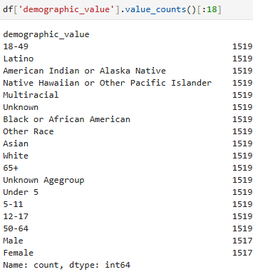
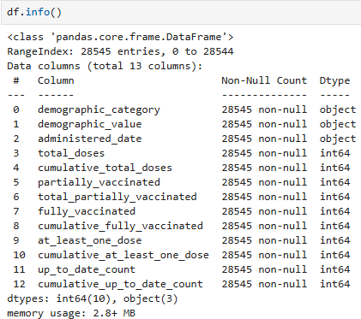
Dissection of Data set

Slide 9
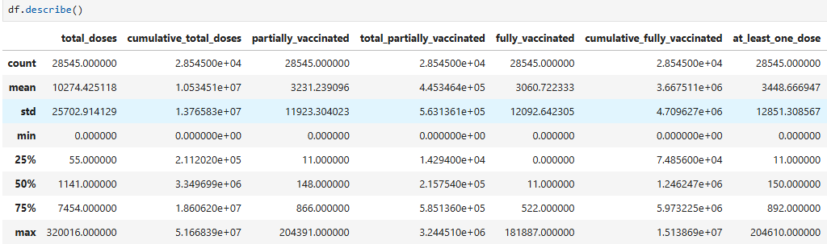

Slide 10
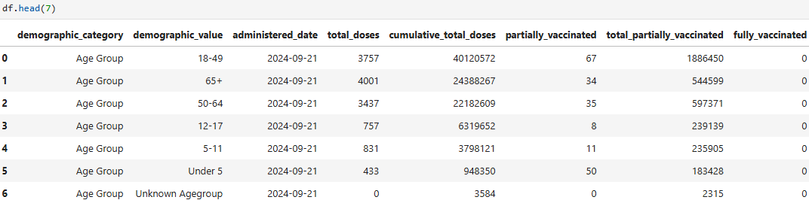

Slide 11
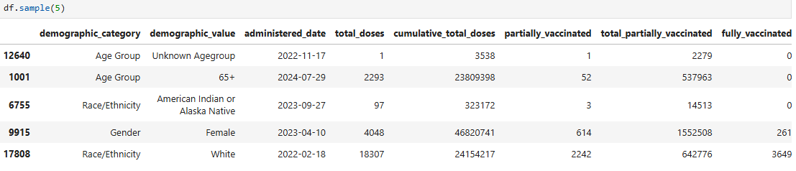

Slide 12
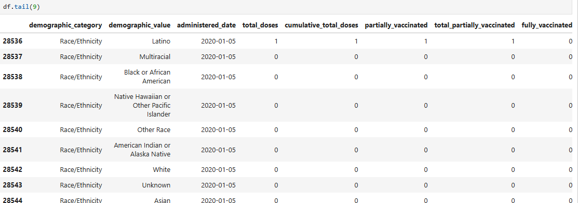

Slide 13
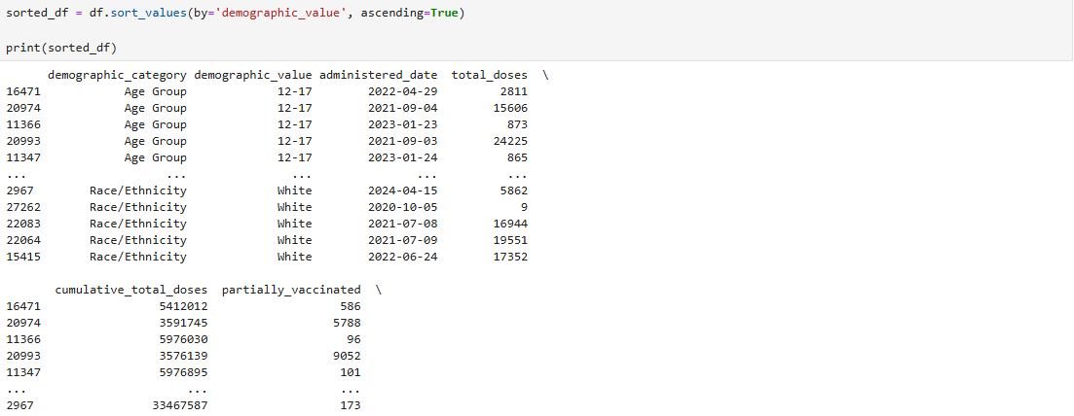

Slide 14
Analyzing the data
The data starts on 2020-01-05 and goes up into 2024-09-21.
Ages 18 - 49 has the most cumulative_total_doses and female has the most cumulative_total_doses as well.
Barely any age nor gender was considered fully vaccinated.
Most people were considered partially vaccinated.
Most kids or teenagers under the age of 17 weren’t vaccinated at all or had at least one dose.
Most adults had consider taking only one dose.

Slide 15
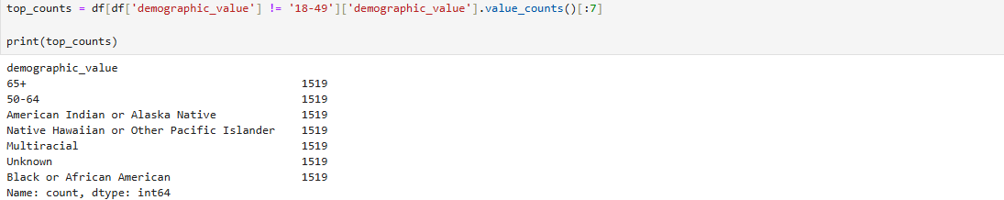
Graphing and more Analyzing

Slide 16

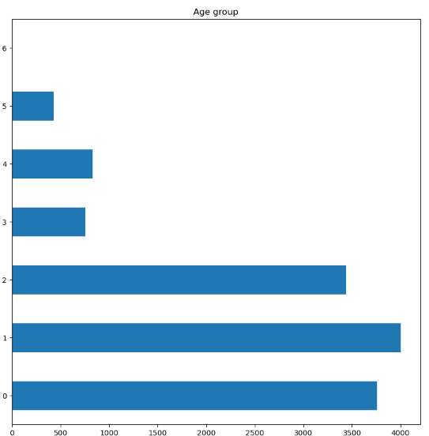
6 - Unknown Age group
5 - Under 5
4 - 5 - 11
3 - 12 - 17
2 - 50 - 64
1 - 65+
0 - 18 - 49
(2024 - 09 -21)

Slide 17
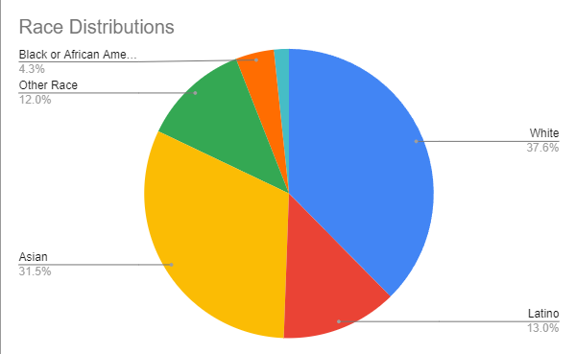
(2024 - 09 - 21)

Slide 18
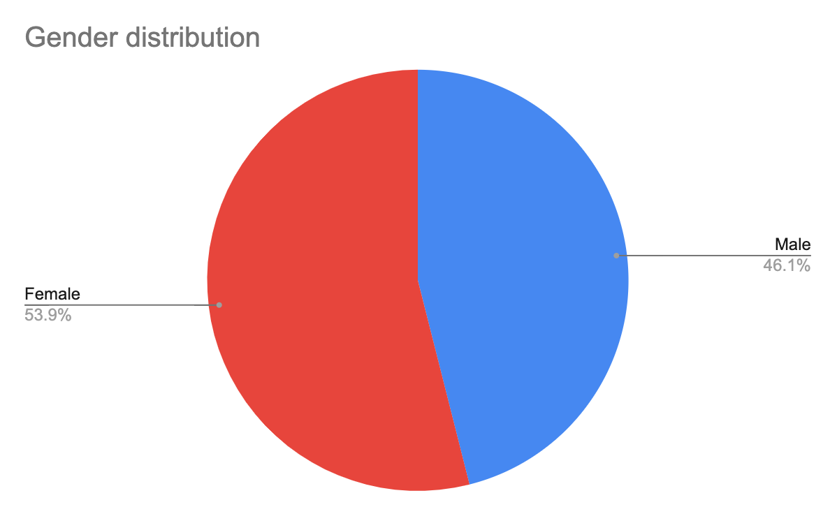
(2024 - 09 - 21)

Slide 19
My Findings
My charts describe that age and race may be a factor in the distribution of the vaccine. As White and Asians both commonly have the most total doses. The other races are more on the lower ends. As for the ages it seems as people who are 64+ or 18 - 49 have the most age distribution among themselves.

Slide 20
Problems with my findings
Although, I do realize there may be problems with my findings. I had gather information from a certain year and day instead of getting it from a variety of years. With this in mind my graphs and conclusions may be inaccurate because of this.

Slide 21
Conclusion
However, I come to is that there simply isn’t enough information that I worked with in order to come to an conclusion if there were factors when it comes to who gets the vaccine first. I believe other factors such as economic status or political status. With this in mind its very difficult to say exactly with just working with race, age and gender.

Slide 22
Sources
https://data.who.int/dashboards/covid19/cases
https://covid.cdc.gov/covid-data-tracker/#datatracker-home
https://data.chhs.ca.gov/
https://ourworldindata.org/covid-vaccinations

